Slide 1















Vehicle Number Plate Enhancement & Recognition
Supervised by Fakhruddin Basha Sir

Slide 2

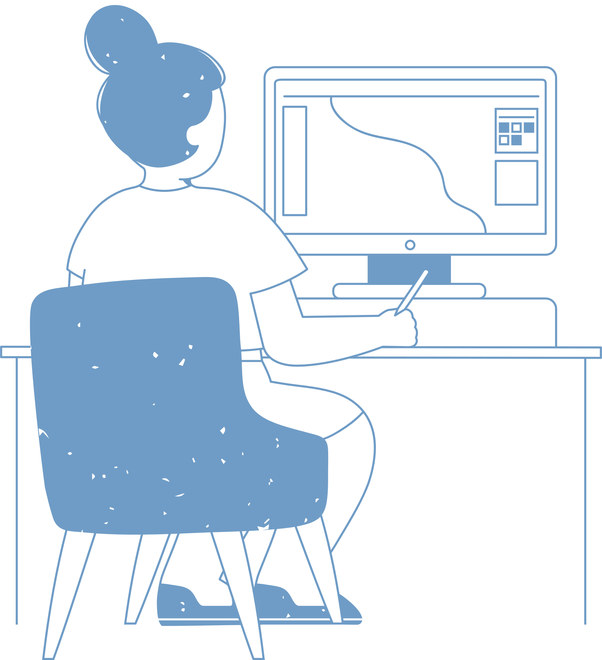
Introduction
Image Restoration is basically an operation or set of operations performed on noisy input image to estimate a latent clean and noise free output image. Noises found in image are mainly gaussian noise, salt-and-pepper noise, camera mis-focus etc. Motion blur occurs due to prolonged exposure time which creates blurry artifacts. It is the effect of relative motion between camera, objects and scene. Number plate is an identification number that peculiarly identifies the vehicle owner. It can be useful in identifying problematic vehicles like in road accidents or catching any rule violating vehicle.

Slide 3
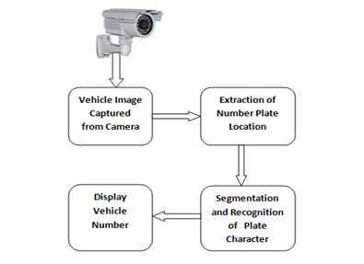
Objective’s
Fast motion of vehicles may lead to difficulty in identifying the number plate by surveillance camera. Due to rapid motion of car the picture perceived by the camera develops a blur.
The aim of this work is the retrieval of latent image which reduces the strain on human eyes in recognizing the blurry number plate. It can be useful in identifying problematic vehicles like in road accidents or catching any rule violating vehicle.
This type of system is widely used in Traffic control areas, tolling, parking area.etc. This system is mainly designed for the purpose of security system.

Slide 4
Median Filter is used to filter and remove salt and pepper noise.
An adaptive equalization method is used to enhance the contrast.
01.
Algorithms and Filters used
Gaussian filter is used to smooth the adaptive equalized image.
Dilation of Binary gradient masking is used to remove noise from the image.
02.
A series of filters and algorithms have been used to enhance the captured image’s and produce a sourcable output to determine and recognize the plates of vehicles.
The edge filter is used to detect the edges and media filtering is used to retrieve a filtered histogram image.
03.

Slide 5
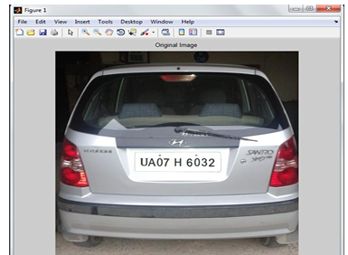
Original Image

Slide 6
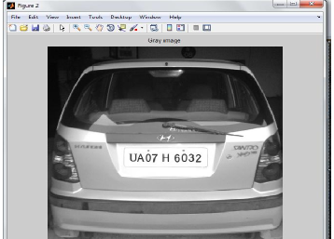
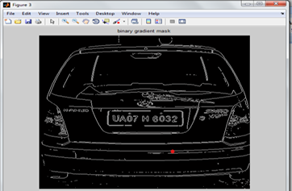
Grayscale
After applying dilate and erode filter

Slide 7
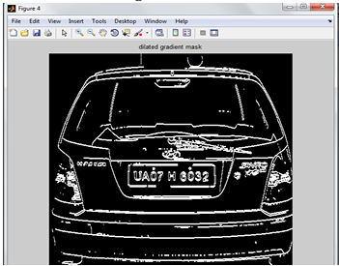
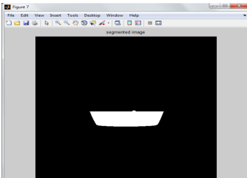
After applying smoothening filters
Extracting the number plate

Slide 8
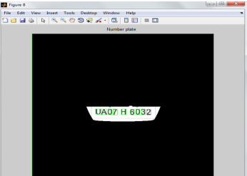
Extracted number plate image

Slide 9

Parking
Border
Security
- The car number is registered in the entry or exits to the country and used to monitor the border crossings.
The program is used to automatically enter prepaid members and calculate parking fee for non members.
Access control
Traffic
Control
The vehicles can be directed to different lanes according to their entry permits. The system reduces the traffic congestions and number of attendants.
Applications
A gate automatically opens for authorized members in a secured area, thus replacing or assisting the security guard.
Where can it be used
Airport
Parking
Toll
In order to reduce ticket frauds or mistakes, the NPR unit is used to capture the number plate and image of the car.
The car number is used to calculate the travel fee in a toll-road or used to double check the ticket.

Slide 10

Final Conclusions and Limitations
In this system , an application software is designed for the detection of number plate of vehicles using their number plate. At first plate location is extracted using morphological operation then separated the plate characters individually by segmentation. Finally template matching is applied with the use of correlation for recognition of plate characters. Some of possible difficulties:
1. Broken number plate.
2. Blurry images.
3. Number plate not within the legal specification.
4. Low resolution of the characters.
5. Poor maintenance of the vehicle plate. Similarity between certain characters, namely, O and D; 5 and S; 8 and B, E; O and 0, etc.

Slide 11
[1] R.Radha1 and C.P.Sumathi2, “A Novel approach to extract text from license plate of vehicle”, Signal & Image Processing : An International Journal (SIPIJ) Vol.3, No.4, August 2012 .
[2] Shen Zheng Wang & His-Jian Lee “Detection and Recognition of License Plate Characters with Different Appearances”,IEEE Intelligent Transportation Systems, Proceedings 2003 , vol.2 , Page(s): 979 – 984.
[3] Humayun Karim Sulehria, Ye Zhang, Danish Irfan, Atif Karim Sulehria, “ Vehicle Number Plate Recognition Using Mathematical Morphology and Neural Networks”, WSEAS TRANSACTIONS on COMPUTERS, Volume 7,ISSN: 1109-2750, Issue 6, June 2008.
[4] Dr. P.K.Suri, Dr. Ekta Walia, Er. Amit Verma,” Vehicle Number Plate Detection using Sobel Edge Detection Technique”, International Journal of Computer Science and Technology, ISSN : 2229 – 4333, IJCST Vol. 1, Issue 2, December 2010.
References

Slide 12
Thank you!
Presented By :
H S Uthkarsh
Amaan Masood Hagalwadi
Syed Nabil
Shaik Shoban
Pavan Reddy

